Slide 1

Stroke Prediction Healthcare
This presentation explores the application of data analysis and machine learning for stroke prediction, highlighting the potential to improve healthcare outcomes.
by Vinayak Mehta

Slide 2
Dataset Overview
Patient Data
Problem Statement
The dataset includes patient demographics and health-related information, such as age, gender, hypertension, heart disease, and glucose levels.
The primary objective is to analyze the dataset and understand the factors contributing to strokes, with the ultimate goal of building a predictive model to help healthcare providers identify patients at high risk.

Slide 3
Data Exploration and Pre-processing
1
Import Libraries and Load Dataset
2
Dataset Overview and Basic Metrics
3
Statistical Summary of Categorical Data
We begin by importing necessary libraries and loading the stroke dataset into a pandas DataFrame.
This step involves exploring basic information about the dataset, including missing values, data types, and statistical summaries.
We analyze categorical columns to identify unique factors, missing values, and the need for data type conversions.
4
Handle Missing Values
5
Data Type Conversions
We address missing values effectively, considering imputation or removal based on the significance of missing data.
We convert relevant columns to categorical or integer data types to optimize memory usage and ensure correct data types.

Slide 4
Data Analysis Framework
1
Data Exploration
This phase involves identifying categorical variables, non-graphical analysis using value_counts() and unique(), and graphical analysis using count plots to visualize the distribution of each variable.
2
Trend Analysis
We analyze trends in stroke occurrences over time, grouping data by age or year and visualizing with a line plot.
3
Comparative Analysis
We compare stroke occurrences in patients with and without hypertension and heart disease using count plots.
4
Duration Analysis
If available, we analyze hospitalization duration for stroke patients and how it varies based on demographics or medical history.
5
Best Practices in Stroke Prevention
We analyze how lifestyle factors such as smoking status and BMI correlate with stroke occurrences.
6
Factor Analysis
We identify influential factors, like age, gender, and lifestyle, that are most strongly associated with stroke occurrences.
7
Geographic Analysis
If geographical data is available, we analyze the prevalence of stroke cases across different regions.

Slide 5
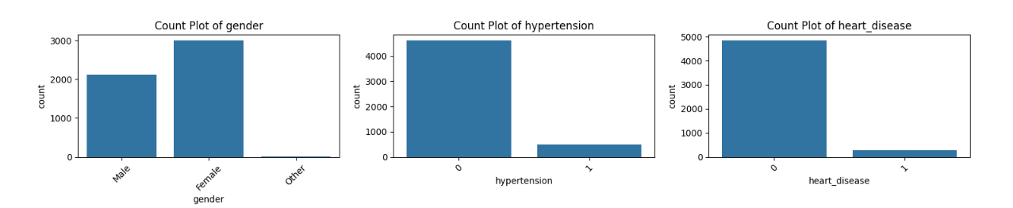
Data Visualization
Counts of Each Categorical Variable

Slide 6
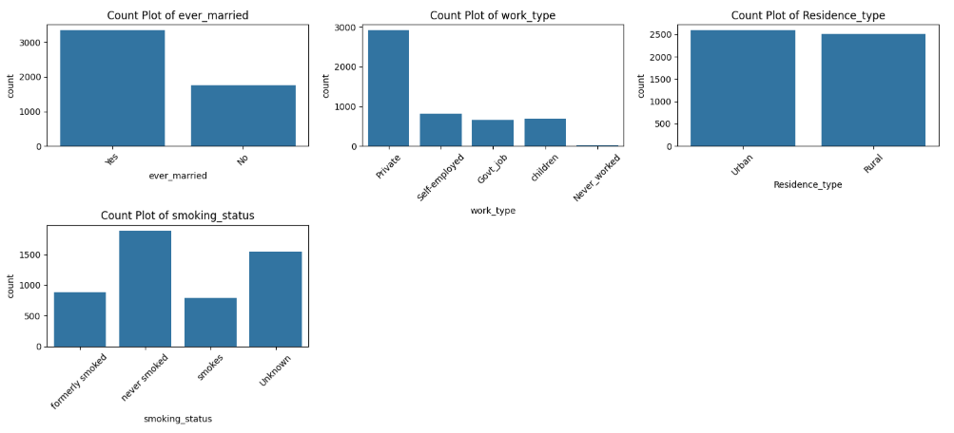
Data Visualization
Counts of Each Categorical Variable

Slide 7
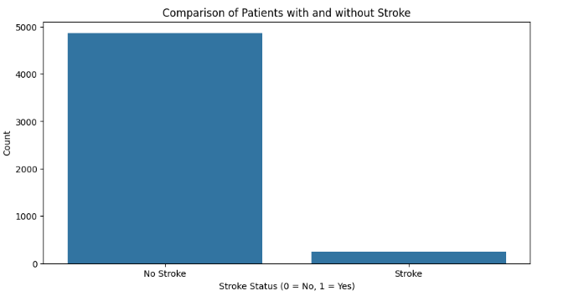
Data Visualization
Comparison of Patients with and without Stroke

Slide 8
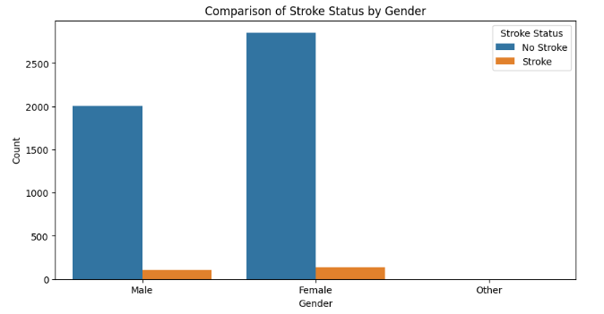
Data Visualization
Stroke Patients by Gender

Slide 9
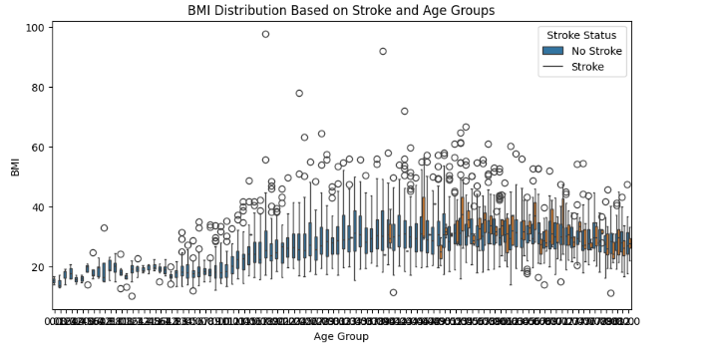
Data Visualization
Duration Based on Age Groups

Slide 10
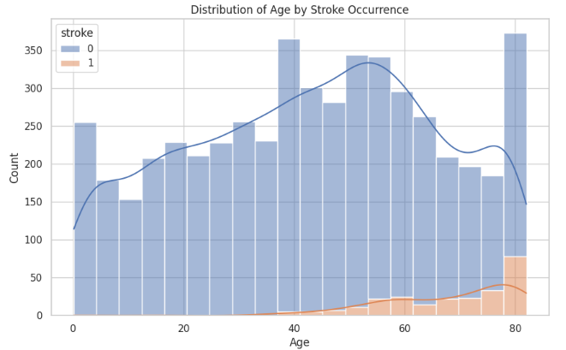
Data Visualization - Pairplot
Plot 1: Distribution of Age, with hue for stroke occurrences
Age Distribution by Stroke Occurrence
Observation: The age distribution plot indicates that stroke occurrences increase with age, especially for individuals aged 50 and above. Younger individuals show a lower frequency of stroke, suggesting age as a potential risk factor.

Slide 11
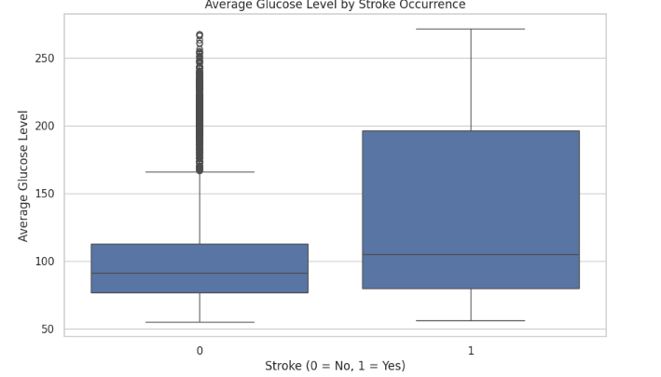
Data Visualization - Pairplot
Plot 2: Boxplot of Average Glucose Level by Stroke
Average Glucose Level by Stroke Occurrence
Observation: The boxplot of average glucose levels reveals that individuals who had a stroke generally show higher glucose levels compared to those who did not. This could indicate that elevated glucose levels are associated with an increased risk of stroke.

Slide 12
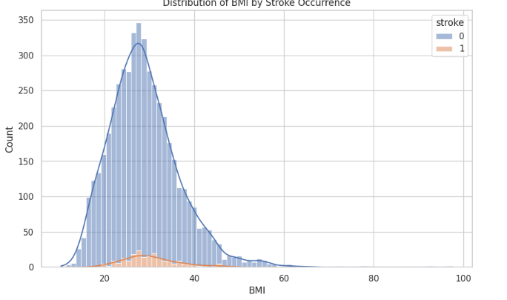
Data Visualization - Pairplot
Plot 3: Distribution of BMI by Stroke Occurrence
BMI Distribution by Stroke Occurrence
Observation: The BMI distribution does not show a drastic difference between stroke and non-stroke groups, but individuals with higher BMI may have a slightly higher tendency toward stroke. Further analysis could determine if BMI is a significant factor.

Slide 13
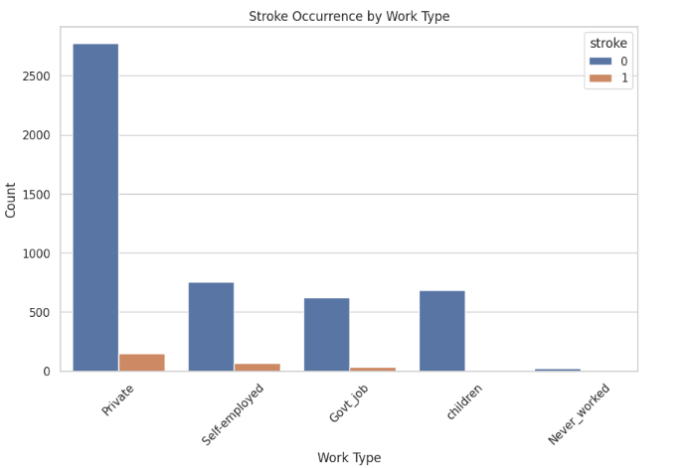
Data Visualization - Pairplot
Plot 4: Bar Plot of Stroke Occurrence by Work Type
Stroke Occurrence by Work Type
Observation: The plot of stroke occurrence across different work types suggests that individuals in certain job categories, like "Self-employed" and "Private," have higher instances of stroke. Those categorized as "Never_worked" have significantly lower instances, potentially due to younger age or other factors.

Slide 14
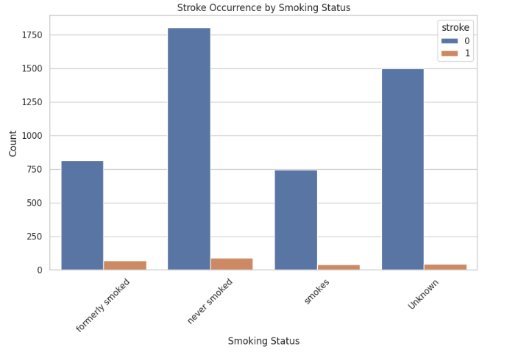
Data Visualization - Pairplot
Plot 5: Bar Plot of Stroke Occurrence by Smoking Status
Stroke Occurrence by Smoking Status
Observation: The count plot shows that individuals who are current or former smokers have a higher incidence of stroke compared to those who never smoked. This suggests that smoking history could contribute to stroke risk.

Slide 15
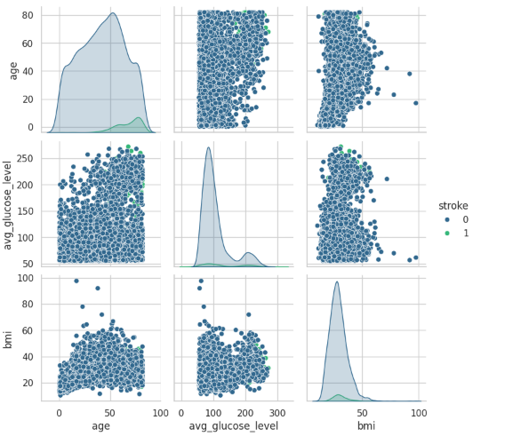
Data Visualization - Pairplot
Pairplot: Relations among Age, Avg Glucose Level, and BMI for stroke variable

Slide 16
Data Visualization Insights
Age Distribution
Glucose Levels
Work Type
The age distribution plot indicates that stroke occurrences increase with age, especially for individuals aged 50 and above.
The boxplot of average glucose levels reveals that individuals who had a stroke generally show higher glucose levels compared to those who did not.
The plot of stroke occurrence across different work types suggests that individuals in certain job categories, like "Self-employed" and "Private," have higher instances of stroke.

Slide 17

Data Encoding and Preparation
Residence Type Encoding
We convert "Residence_type" to binary: Urban = 1, Rural = 0.
Work Type Encoding
We create binary columns for key work types: "Never_worked," "Private," and "Self-employed."
Smoking Status Encoding
We create binary columns for "formerly smoked," "never smoked," and "smokes."
Final Dataset
We drop original columns and save the transformed dataset to a new variable, ready for model training.

Slide 18





Logistic Regression: Predicting Stroke Risk
1
Objective
Understanding Logistic Regression
2
Logistic Regression is a supervised learning algorithm used for binary classification tasks, where the output variable is discrete and consists of two possible classes.
Mathematical Explanation
3
The core of logistic regression is the logistic function (also called the sigmoid function), which is used to model the probability that a given input belongs to class 1 (e.g., stroke = 1).
Optimization and Cost Function
4
Logistic Regression tries to find the best parameters that minimize the error between the predicted probabilities and the actual target values.
5
Gradient Descent
To minimize the cost function, we use an optimization algorithm like gradient descent.

Slide 19
Logistic Regression
Objective
To predict the likelihood of a patient experiencing a stroke using logistic regression.
This involves building the model, explaining the underlyingmathematical concepts,
and evaluating its performance.
Understanding Logistic Regression
Logistic Regression is a supervised learning algorithm used for binary classification tasks, where the output variable is discrete and consists of two possible classes. In the context of this project, we are trying to predict whether a person has a stroke (1) or not (0) based on various input features such as age, average glucose level, BMI, and others.

Slide 20
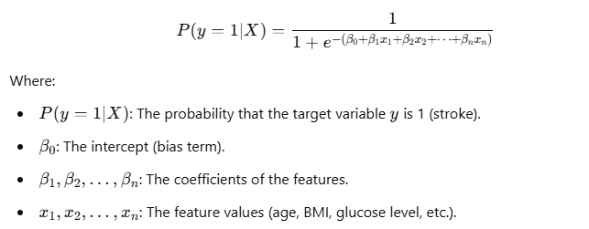
Logistic Regression
Mathematical Explanation:
The core of logistic regression is the logistic function (also called the sigmoid function), which is used to model the probability that a given input belongs to class 1 (e.g., stroke = 1).
The logistic function is defined as:
The logistic function, or sigmoid function, maps any real-valued number (which can be positive or negative) into a range between 0 and 1. This is ideal for binary classification, as the output is a probability value.

Slide 21
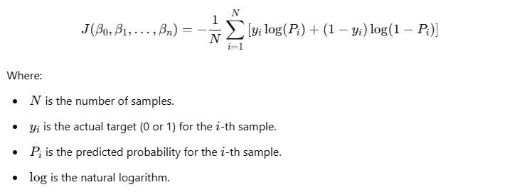
Logistic Regression
Optimization and Cost Function:
Logistic Regression tries to find the best parameters that minimize the error between the predicted probabilities and the actual target values. The error is measured using a cost function, specifically log-loss (also called binary cross-entropy), which quantifies how well the model's predictions align with the true labels.
The log-loss function is given by:
The cost function penalizes the model more heavily for large errors in predictions, encouraging it to adjust the model parameters in such a way that the predicted probabilities align with the true labels.

Slide 22
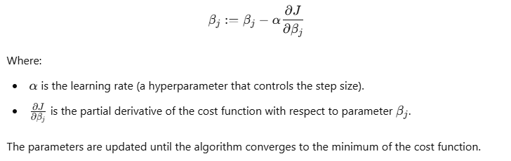
Logistic Regression
Gradient Descent:
To minimize the cost function, we use an optimization algorithm like gradient descent. Gradient descent updates the parameters iteratively in the direction of the negative gradient (steepest descent) to find the values that minimize the cost function.
The update rule for the parameters is as follows:

Slide 23





Model Training and Evaluation
Data Preprocessing
Data Splitting
Model Training
Model Evaluation
We fill missing values in the bmi column with the median value. We encode categorical columns using Label Encoding and scale numerical features using StandardScaler.
The dataset is split into training and testing sets (80% for training, 20% for testing) using train_test_split.
We initialize the LogisticRegression model, setting random_state for reproducibility and max_iter=1000 to ensure convergence.
The trained model is used to predict stroke outcomes on the test data. The accuracy of the model is calculated by comparing the predicted values with the actual values.

Slide 24
Results and Insights
95%
Accuracy
The accuracy score is printed to evaluate the model's performance on the test data.
80.58%
Precision
Precision, recall, and F1 score are printed to evaluate the model's positive prediction accuracy, sensitivity, and balance, respectively.
77.33%
Recall
70.64%
F1 Score

Slide 25
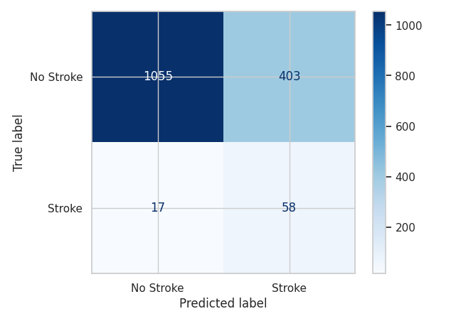
Confusion Matrix
True Negatives (No Stroke): Majority of non-stroke cases correctly identified.
False Positives: Some non-stroke cases incorrectly predicted as stroke.
True Positives: Most stroke cases correctly identified.
False Negatives: Few stroke cases missed by the model.

Slide 26
Model Performance
Where the Model Performs Well:
High Accuracy: The model achieved an accuracy of approximately 94.19%, indicating that it correctly predicted stroke and non-stroke instances in most cases.
Effective in Predicting Common Outcomes: Logistic Regression, being a linear model, works well for predicting binary outcomes, especially when the classes are linearly separable.
Feature Importance: The model is interpretable, allowing us to understand which features (e.g., age, average glucose level, hypertension) contribute most to predicting stroke, helping us gain insights into stroke risk factors.

Slide 27
Model Performance
Where the Model Lacks:
Imbalanced Dataset: The dataset contains fewer stroke instances compared to non-stroke instances, leading to a potential class imbalance. Logistic regression may perform poorly in predicting the minority class (stroke) if not handled properly.
Solution: Techniques like oversampling (e.g., SMOTE), undersampling, or adjusting class weights can be used to tackle class imbalance.
Precision and Recall: While accuracy is high, precision and recall are lower. Precision refers to the proportion of true positive stroke cases out of all predicted stroke cases, and recall refers to the proportion of true stroke cases out of all actual stroke cases.
Solution: Precision can be improved by adjusting the decision threshold or by using other algorithms like Random Forest or XGBoost, which are better at handling imbalanced datasets.

Slide 28
Dataset Bias Analysis
Was the Dataset Biased?
The dataset shows some level of class imbalance. The majority of the instances are non-stroke (stroke = 0), which makes it a biased dataset in terms of the outcome variable (stroke vs. no stroke). The imbalance could lead to the model being biased toward predicting the majority class (non-stroke).
Tackling Bias in the Dataset:
To address class imbalance, we can use the following methods:
Class Weight Adjustment: This was already applied by using class_weight='balanced' in the logistic regression model. This gives more importance to the minority class (stroke) during training.
Resampling Techniques:
Oversampling: Use techniques like SMOTE (Synthetic Minority Over-sampling Technique) to generate synthetic examples of the minority class.
Undersampling: Reduce the number of majority class examples to balance the dataset.
Evaluation Metrics: Instead of relying solely on accuracy, use metrics like precision, recall, and F1 score to evaluate model performance on imbalanced datasets.

Slide 29
Observations and Recommendations
Observations:
Important Features: Age, average glucose level, and hypertension are the most significant predictors of stroke, according to the feature importance scores.
Performance Gaps: The logistic regression model has high accuracy but suffers from low precision and recall. This is likely due to class imbalance.
Class Imbalance: The dataset contains more non-stroke instances than stroke instances, which affects model performance. Class imbalance can lead the model to favor the majority class (non-stroke).
Linear Model Limitation: While logistic regression is simple and interpretable, it may not capture complex relationships in the data as well as other models (e.g., Random Forest, XGBoost).

Slide 30
Observations and Recommendations
Recommendations:
Address Class Imbalance: Implement techniques like SMOTE or undersampling to balance the dataset and improve model performance on the minority class.
Try More Complex Models: Consider models like Random Forests, Gradient Boosting, or XGBoost for better handling of non-linear relationships and imbalanced data.
Threshold Tuning: Adjust the decision threshold to optimize precision and recall according to the specific application (e.g., minimizing false negatives might be crucial in stroke prediction).
Feature Engineering: Additional feature engineering, such as creating new features based on domain knowledge, could help improve model performance.
Evaluation with Multiple Metrics: Given the class imbalance, use evaluation metrics like F1 score, precision, and recall rather than just accuracy to get a clearer picture of model performance.

Slide 31
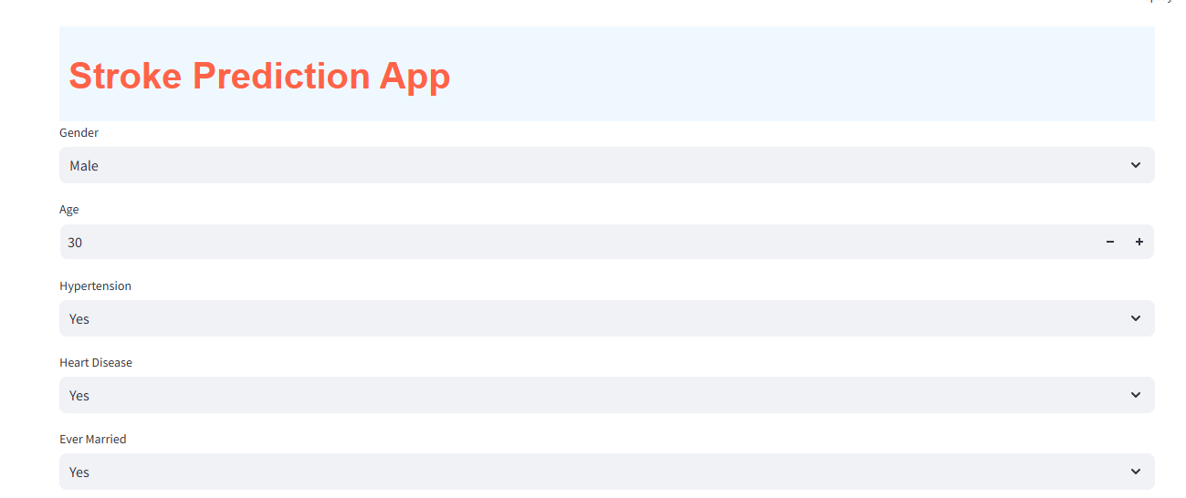
Stroke Prediction Web App
This web app predicts the risk of stroke based on user inputs such as age, gender, health conditions, and lifestyle factors. It features an intuitive interface with colorful, styled outputs, providing a clear risk assessment and probability score using a trained machine learning model.

Slide 32
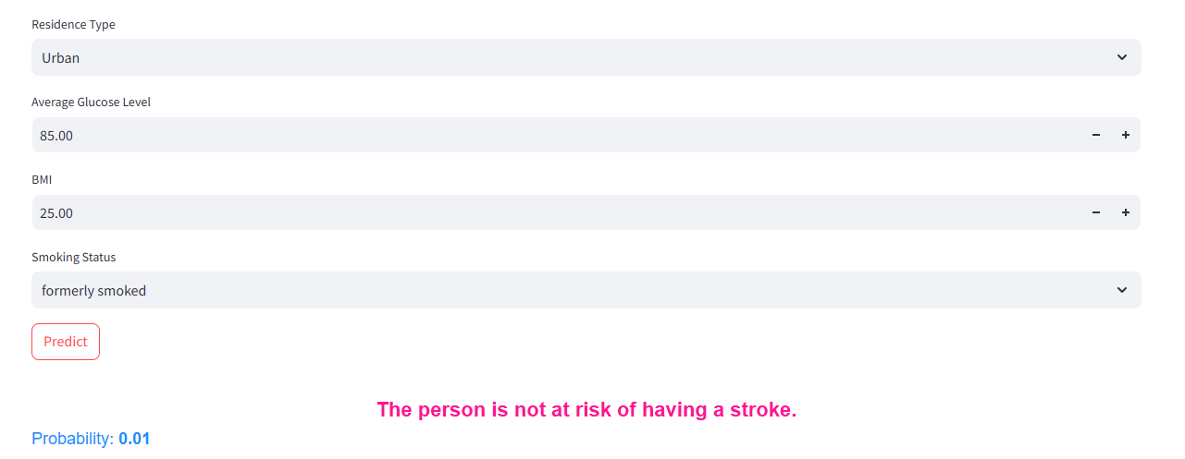
Stroke Prediction Web App
The web app provides a concise prediction indicating whether a person is at risk of a stroke or not. It displays the result along with the probability score, offering clarity and ease of interpretation for users.

Slide 33
Conclusion and Next Steps
Logistic Regression is a powerful tool for predicting stroke risk, demonstrating the potential of data-driven approaches in healthcare. Future work could explore more complex models, investigate potential biases in the dataset, and integrate real-time data for improved prediction and personalized care.

